Slide 1


Slide 2


Cross-Layer AI-Driven Stuttering Prediction for Video Streaming in High-Speed Subways
Hongyi Wang, Jiawei Zhen, Zhenhua Li, Qibin Zheng

Slide 3
Background
High-speed subways cause severe wireless dynamics: signal shielding, coverage holes, and frequent handovers.
Real-time video streaming apps are highly sensitive to these dynamics and often suffer stuttering.
Existing approaches are reactive: they optimize signal/QoS after degradation.
Bridge low-level network dynamics and app-level QoE with an online Al predictor
Predict stutter risk before playback stuttering

Slide 4
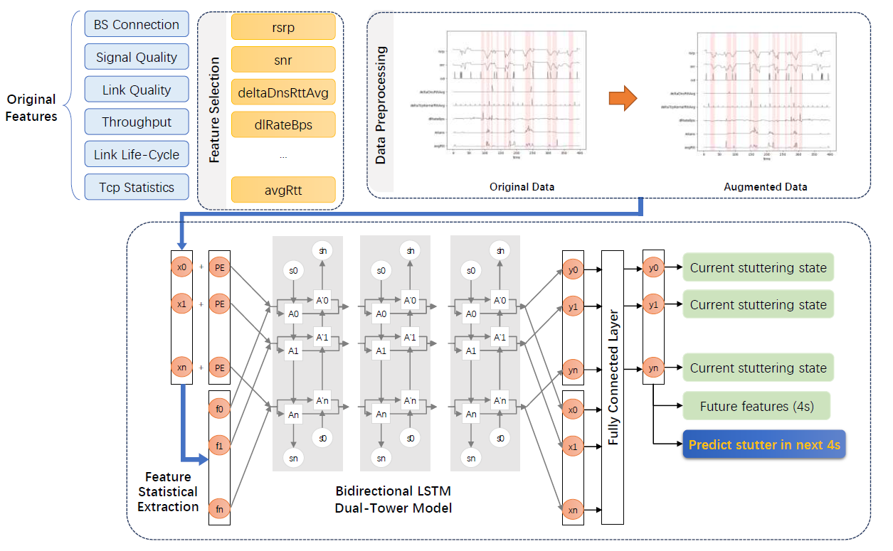
System Design
Overview
Customized Android continuously collect features.
Input: a 40-second history window.
Output: whether there will be stuttering in the next 4 seconds.

Slide 5
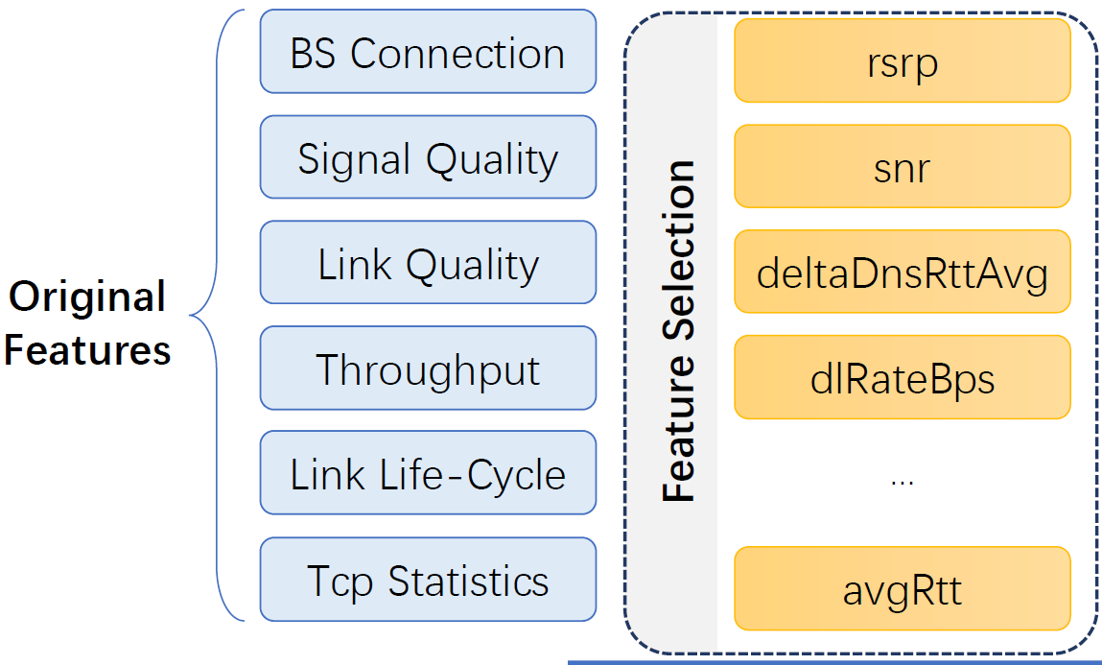
System Design
Data Collection
  Collected on four representative Beijing subway lines.
  Three operators, two apps (Huya and WeChat).
  Raw telemetry sampled every 4 second.
Feature Selection
  Temporal visualization
  Correlation with label
  Expert adjustment
  → 18 features selected

Slide 6
System Design
Data Augmentation
  Challenge: class imbalance
    500 stutter events vs.40.000 non-stutter events
  Temporal reversal: mimics trains moving through the same tunnel in the opposite direction.
  Random temporal swapping: exchange points in sub-windows to inject randomness.
Soft Label:
  Hard label: 0 for non-stutter, 1 for stutter
    Information not enough
  Soft label: combining time to nearest stutter and the duration.

Slide 7

System Design
Multi-Task Dual-Tower Architecture
  Tower 1: Raw 18-dim time series
  Tower 2: 7 statistical metrics (min/max/…)
  → Bi-LSTM encoders → Shared FC layer
  Task 1: predict stutter in next 4 second (soft-label)
  Task 2: historical label (stutter/non-stutter) classification
  Task 3: future feature forecasting
  →Only task 1 is used during real-time usage

Slide 8
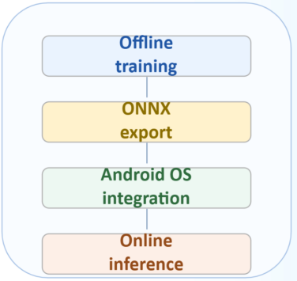
System Design
Implementation
  Training: implemented with PyTorch.
  Trained model: exported to ONNX, integrated into Android for on-device inference.
  At runtime: triggered every 4 seconds and outputs stuttering risk, without external servers.
  Overhead: memory footprint <50 MB, inference latency <0.5s.

Slide 9
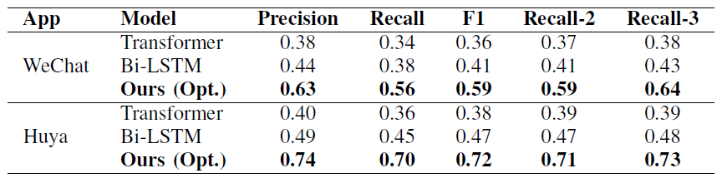
Evaluation
Metrics
  Precision/Recall/F1-score
  F2/F3-score: whether the model catches long-lasting stuttering events (lasting at least 8 s o12 s)
Performance Results

Slide 10
Conclusion
This work builds an OS-integrated, cross-laver Al framework for proactive stuttering prediction in high-speed subway environments.
The predictor achieves strong accuracy with low runtime overhead, making real-time mobile deployment feasible.
This work enables proactive QoE optimization rather than passive recovery after playback degradation occurs.
Future work: high-speed rail and vehicular scenarios.

